Slide 1

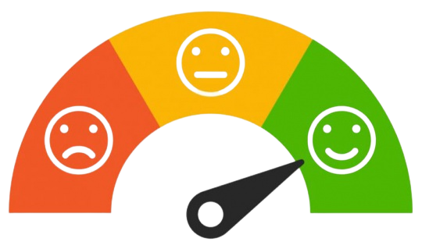
EXPLORATORY DATA ANALYSIS AND EMOTION DETECTION ON WHATSAPP
By : Project Guide
Purushottam Kumar Dr. T. Mala
2020178043 MCA (R) ( Associate Professor )

Slide 2
Objective
Existing system has limitation to analyze text data especially chat conversation and detecting emotion from text is also a major concern.
To develop a system that can analyze WhatsApp chats using Exploratory Data Analysis and illustrate in more visual format to identify hidden insights.
To detect emotion from text using LSTM ( Long Short Term Memory )

Slide 3
Literature Survey
S.No | Title | Problem Statement | Approach | Pros | Cons
1 | Text Classification based Behavioural Analysis of WhatsApp Chats” (June 2020) S. Dahiya, Astha Mohta, Atishay Jain | Classification and analysing sentiment on the basis of emotion and categorise them | Behaviour analysis | To classify emotions (Pos, Neg, Neutral) into six different emotions and uses their Neutrality to weigh them. | Only 72.9% accuracy against a set of pre-classified data.
2 | WhatsApp Network Group Chat Analysis Using Python Programming Blessing Nwamaka Iduh International Journal of Engineering & Applied Science (IJLTEMAS) Volume IX, Feb 2020 | Analysis of the chats and users in certain groups, to ascertain the level of participation of members in the group chat | Exploratory Analysis | Analysis of the top 10 & top 20 users using the Python libraries | Can be implemented only on (24 hr clock & mm/dd/yyyy) format
3 | Analysing and Predicting the Emotion of WhatsApp Chats Using Sentiment Analysis Chinthapanti B Sai Reddy, Kowshik S, Rakesh, Gopichand G | Using LSTM model to categorize the behavior into Angry, Sad, Fear, Happy, Surprised, Excited | Sentiment Analysis | Using priority based model to classify different emotions | Huge amount of data required for analysis

Slide 4
Literature Survey
S.No | Title | Problem Statement | Approach | Pros | Cons
4 | People’s Behavior Analysis in Chat Message using Natural Language Processing V.Selina Annie Retna, P. Brundha, G RajKumar, Mar-2019 | To analyze the sentimental flirt analysis in the private setting of a group in the WhatsApp chat to obtain the exact result for the analysis | Data mining, Natural Language Processing | Web Scrapping the WhatsApp chat and sentimental analysis using deep learning model | for storage the cost was little high for using the cloud storage and can be reduced in the future works
5 | Whatsapp Chat Analyzer Ravishankara K, Dhanush, Vaisakh, Srajan I S International Journal of Engineering Research & Technology (IJERT) Vol. 9 Issue 05, May-2020 | Using python libraries to show level of participation of the various individuals on the given WhatsApp group and addiction | Exploratory data analysis using tools ex- matplotlib, seaborn | Using Data pre-processing & Exploratory data analysis, then apply sentiment analysis algorithm | Limitation of the neglecting of some common words during the chat conversation

Slide 5
Architecture Diagram

Slide 6

Input
User & Messages
User + Message Separation
Structured Text data
Splitting fields
(Regular Expression)
API
Chat
Data
Time & Date
Format Detection
Format Conversion
PushBullet
WhatsApp
Export Chat
Txt File
Day/Time based Features
Final Data Frame Creation
Cleaning
Data Collection
Message Based Features
New Features Addition
Output [1]
Pre-Processing
Output [2]
URL Module
(Shared links info)
User Wise Total sent Msg along with average message length
Involvement Module
(Most active User/ Time/ Weekday)
Clustering different chats into File, text , emoji
Split Equivalent & meaningful Length Sentence
Read Dataset
OUTPUT
Pre-Processing
Evaluation
Emoji Module
Classify as English or Non English
Sentences
[Native Language]
Activity Map Module
[Weekly/Daily]
Timeline Module
(Month/Year wise activity)
Label Encoding
Model Fitting
User_wise_Emoji
[Most used emoji by Each user]
Googletrans
/translators
Fetch_Stats Module
(Total Msg, words, users, links, Media)
Tokenization
Model Building
Word Cloud
Common Words Module
Stop Words
Word Cloud
English Sentences
Padding
Exploratory Data Analysis (EDA)
Language Conversion
Emotion detection
Exploratory Data Analysis (EDA)

Slide 7
Modules
Data Collection Module
Preprocessing Module
Exploratory Data Analysis Module
LSTM Module

Slide 8
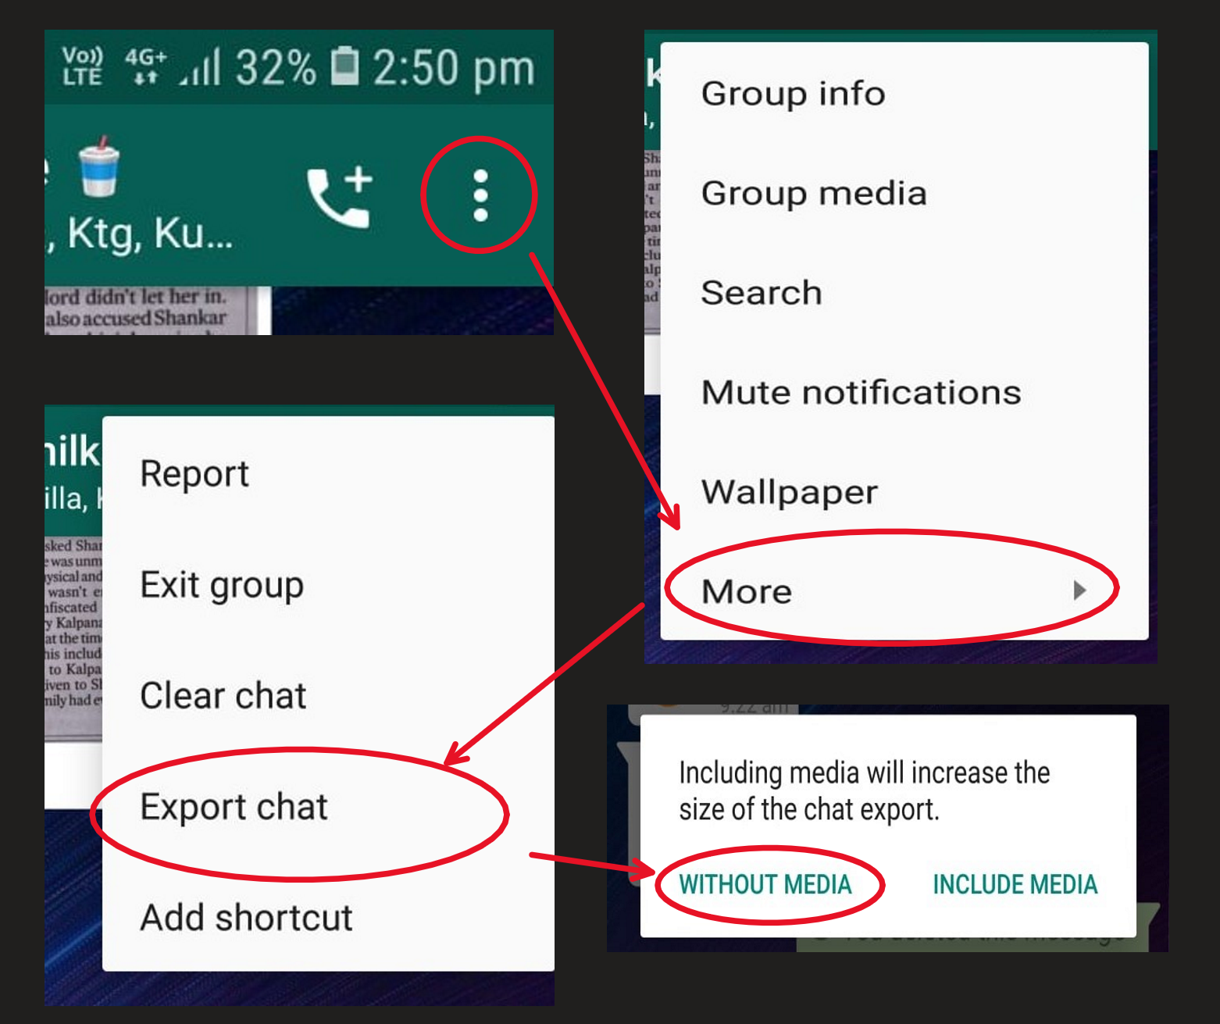
Data Collection Module-i
Method – 1 (Via Mobile)
STEPS TO Follow
Launch the WhatsApp on phone.
Now open the individual or group chat.
Then tap on More options or three dots
Click More, then tap on Export chat.
Choose export without media.

Slide 9
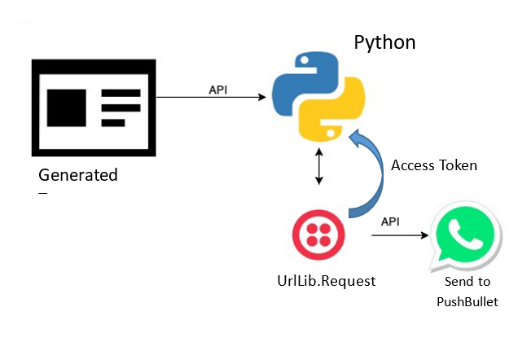
Data Collection Module-ii
STEPS TO Follow
Download Pushbullet app on mobile and sign up with Gmail.
Open PushBullet.com in chrome browser and sign in using same Gmail
In Mobile Export chat to Pushbullet.
Go to settings > account > access Token(API) > Create.
pb = Pushbullet(API_KEY)
Data = pb.get_pushes()
latest = Data[0]
url = latest['file_url']
file_path = "chat.txt"
urllib.request.urlretrieve(url, file_path)
Method – 2 (Using PushBullet Api)
Text

Slide 10
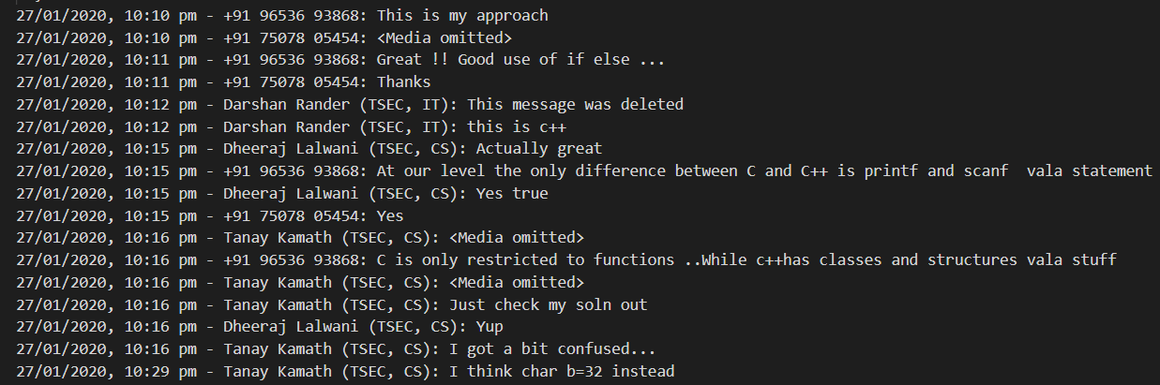
Pre-processing Module-i
Responsible for cleaning, clustering, feature addition, visualisation and further pre-process the text data.
Time-Stamp separation (Splitting Fields)
Using Regular Expression extracting the Time-stamp from given conversation.
Input
Output
+

Slide 11
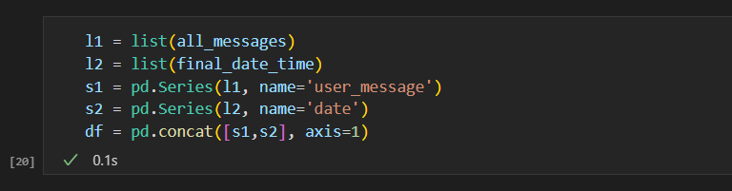
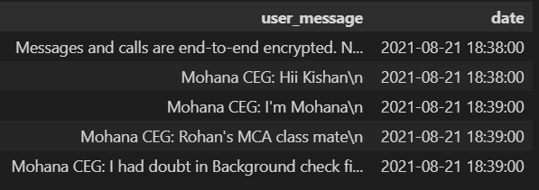
Pre-processing Module-ii
2. Data Frame Creation
From Text file, creation of dataframe will help in further processing.
Using pandas to create dataframe from separated timestamp.
Input
Output
+

Slide 12
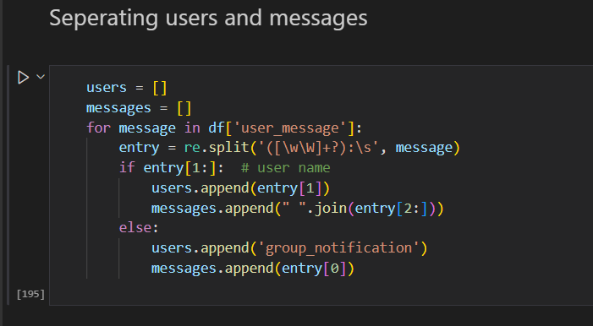
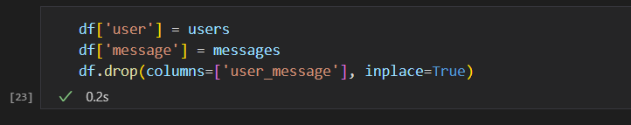
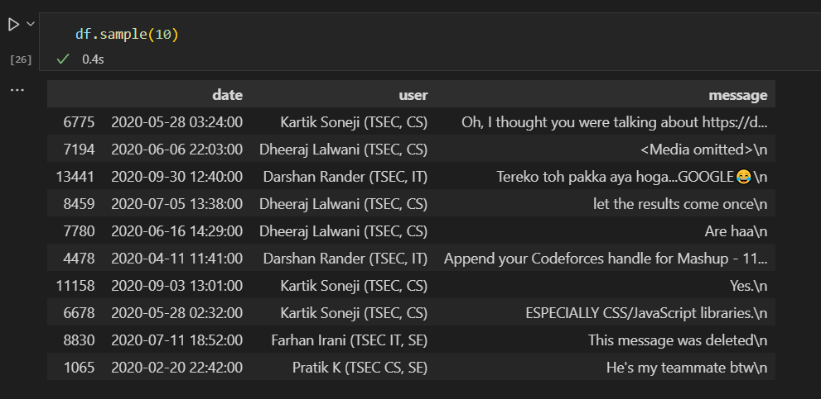
Pre-processing Module-iii
3. Date and Time Format conversation
Converting 12-hr time to 24-hr clock.
Detect different date format an convert it to YYYY/MM/DD
User and Message Separation
Using Regular Expression pattern to splitting message and user
Input
Output

Slide 13
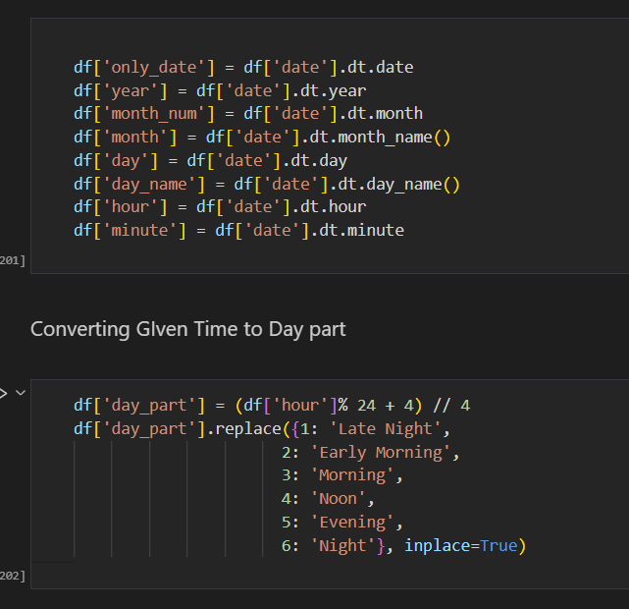
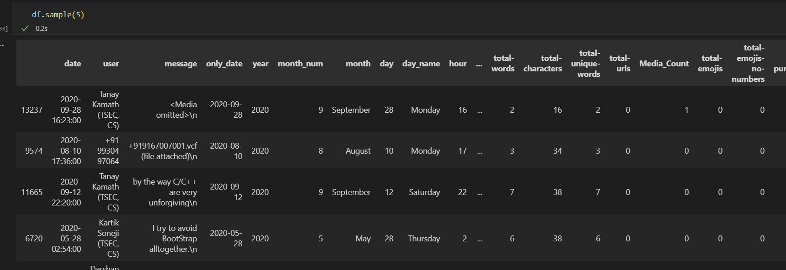

Pre-processing Module-iV
5. Feature Addition / Extraction
Extracting Day, Month, Year from Date using RegEx.
Extracting Hour, Min from Time
Adding them as new feature in dataframe.
Adding two more features as Word count, total characters involved
Total attributes reached up to 26
Final Data Frame
Output

Slide 14
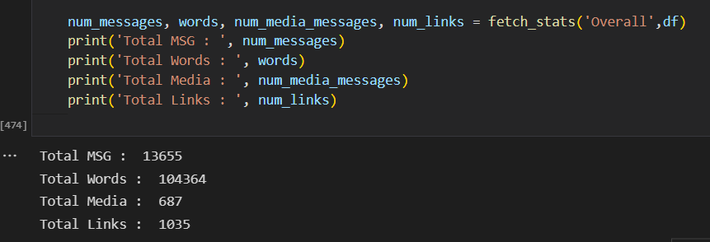
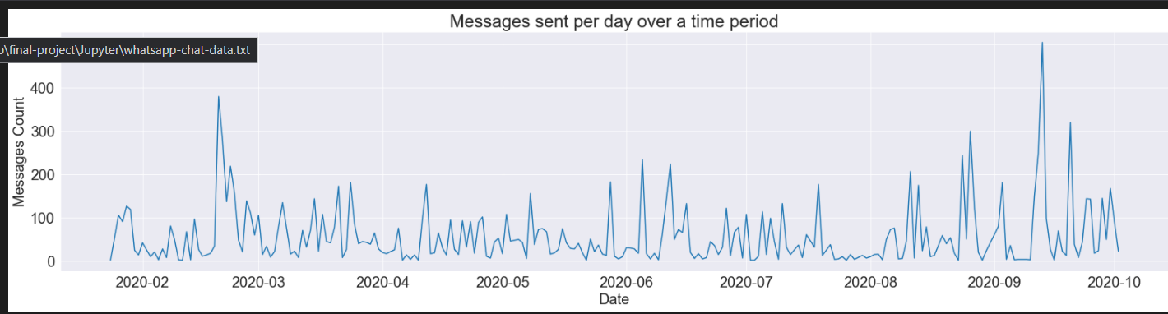
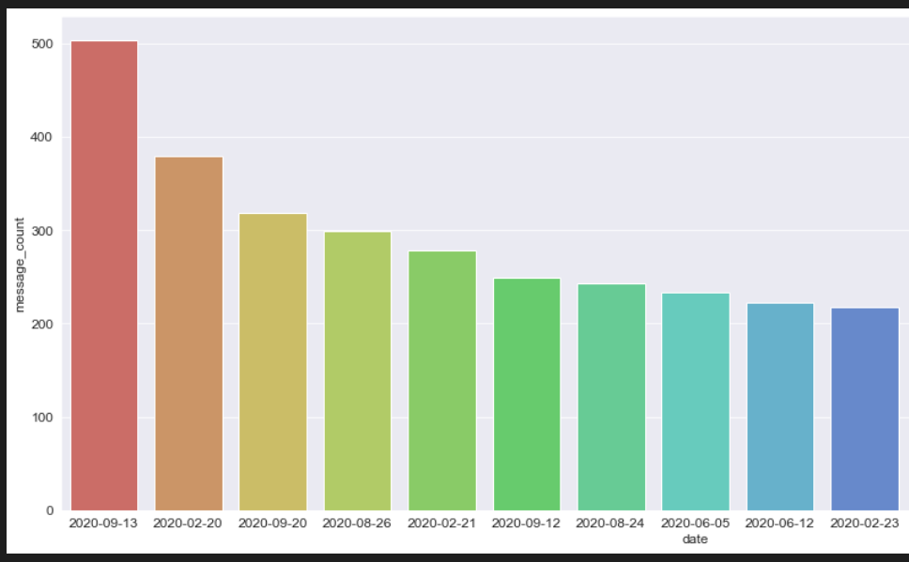
Exploratory Data Analysis-i
Multiples sub-modules are involved in EDA process.
Fetch_stats sub-module
Going through all the messages and filtering the users, URLs , Message and words
and counting them.
For URL identification URLSurf library is used.
Returning statistical information from function
Timeline sub-module
Analysing the time in a day and weekday during which most conversation has been occurred.
It also helps in predicting that which tine us best to send msg so that we can get response
Output

Slide 15
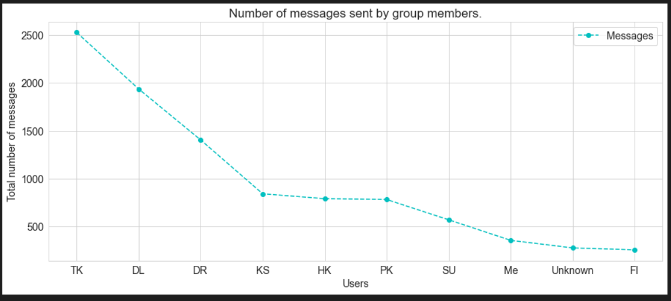
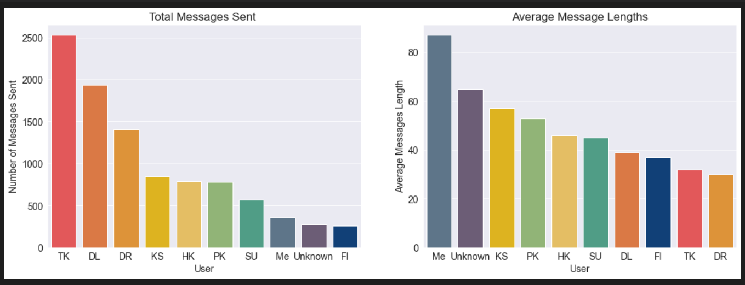
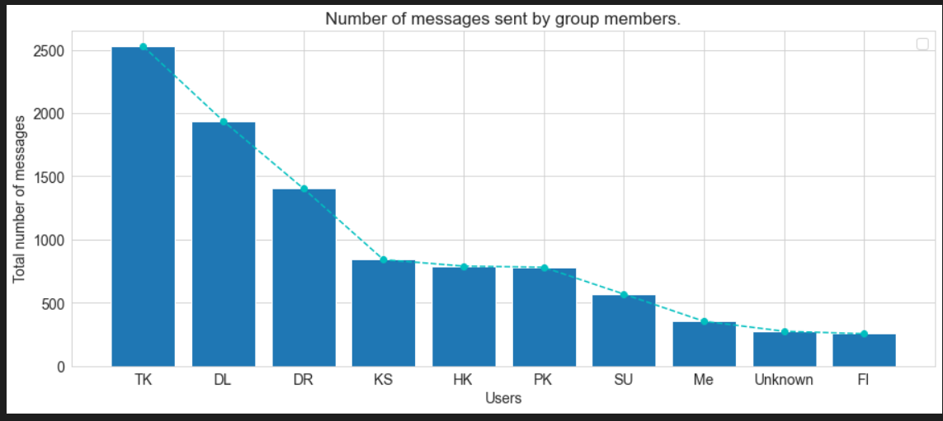
Exploratory Data Analysis-ii
3. Total Msg and avg word length sub-module
Separating each user message and applying count to identify busiest user.
Fetching top users from chat by most no of messages and average length of messages.
Output

Slide 16
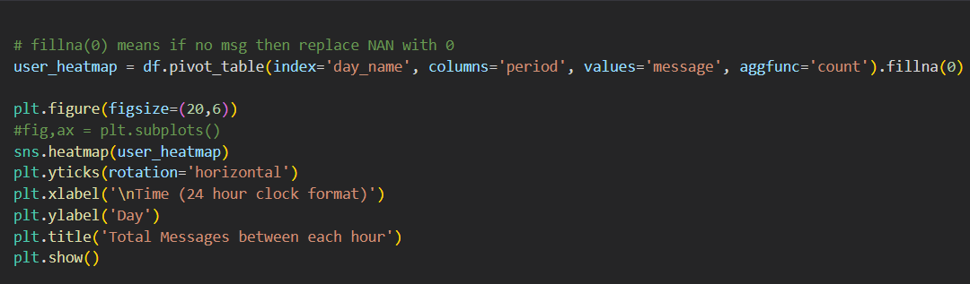
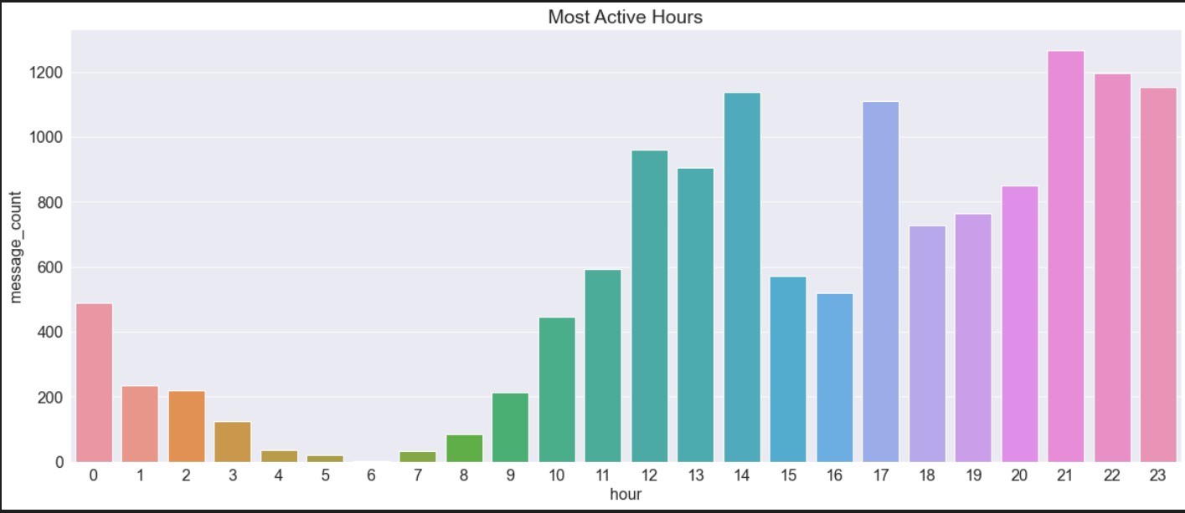
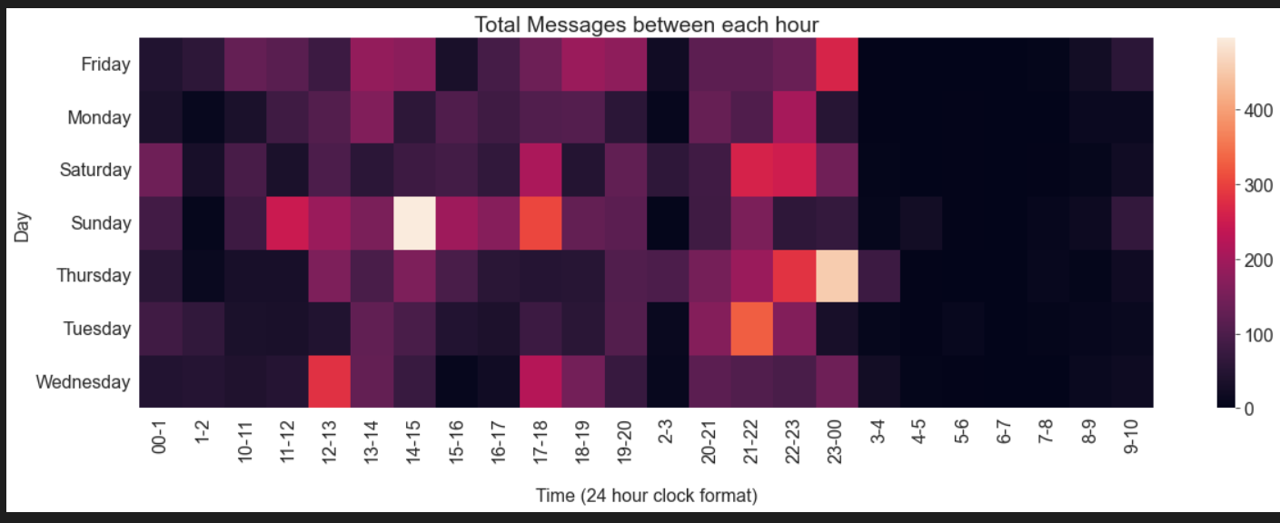
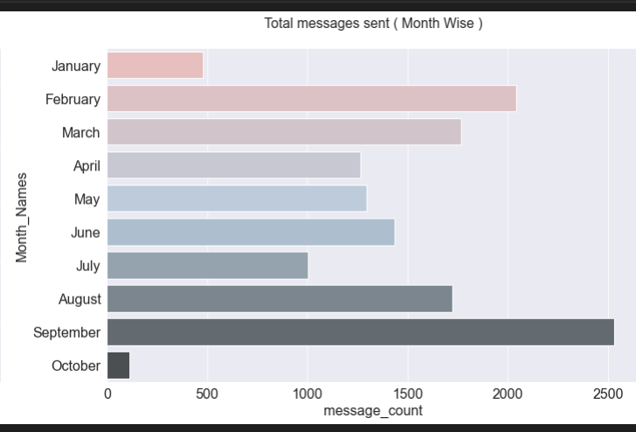
Exploratory Data Analysis-iii
4. Activity Map
Displaying engagement in form of Heat Map.
Fetching day wise activity with respect to time as well.
Output

Slide 17
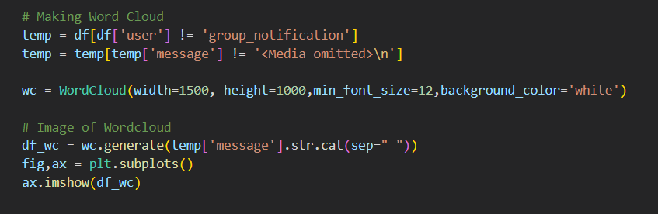
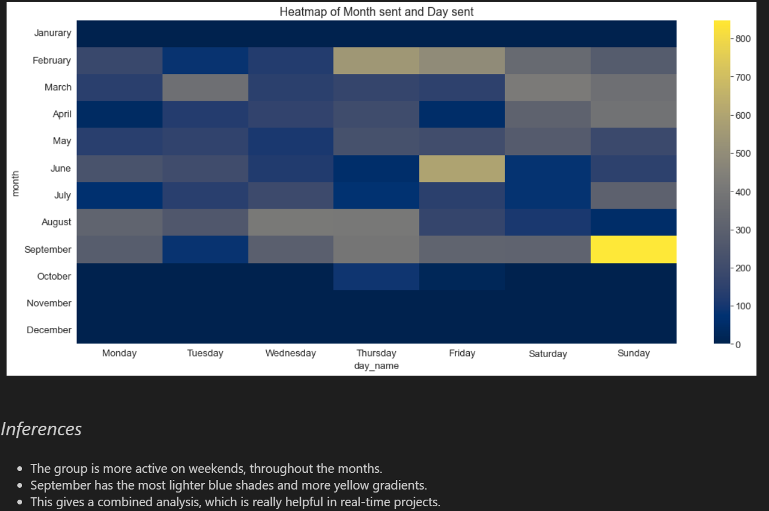
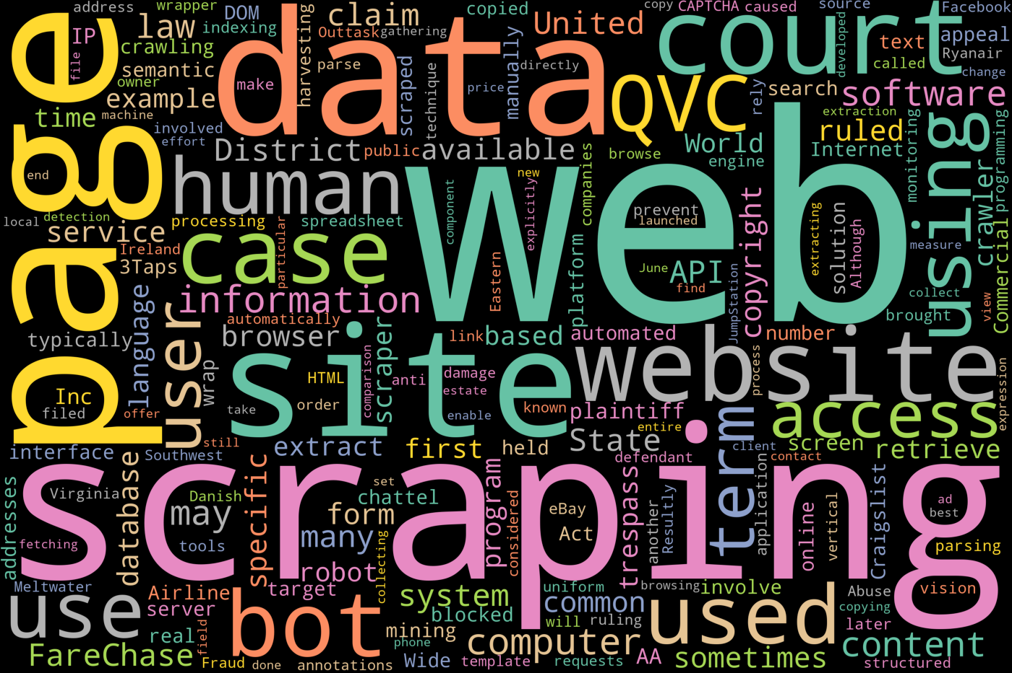
Exploratory Data Analysis-iv
5. Weekly and Monthly Activity
Heatmap representation of monthly and weekly activity
6. Stop Words & Word Cloud

Slide 18
Lstm module

Slide 19
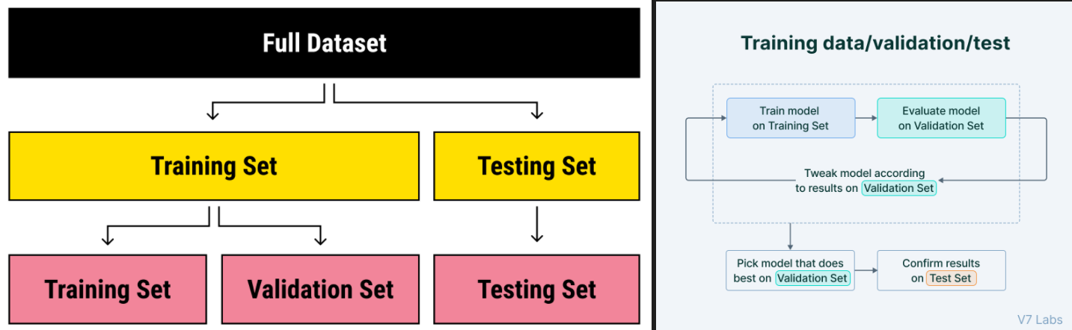
Dataset
Train.txt - The model sees and learns from this data.
Val.txt - Provides an unbiased evaluation of a model fit on the training dataset while tuning model hyperparameters.
Test.txt - Provides an unbiased evaluation of a final model fit on the training dataset.

Slide 20
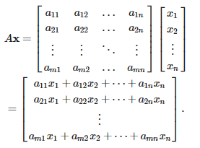
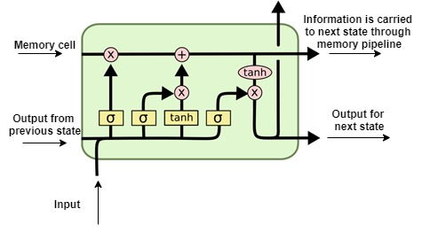
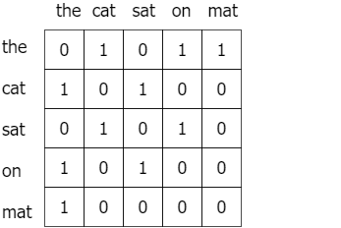
Flow-Chart
Model Fitting
Evaluation
Activation Layer
Read Dataset
Dense Layer
LSTM Layer
Pre-Processing
Max Pooling Layer
Convolution Layer
Label Encoding
Drop Out Layer
Tokenization
Embedding Layer
Model Building
Padding

Slide 21
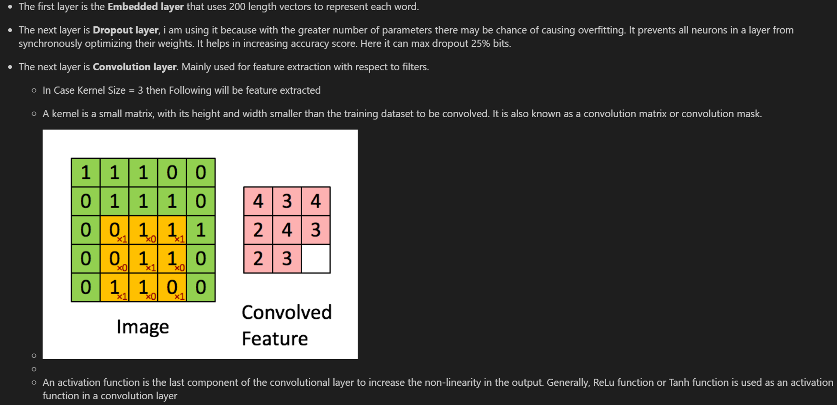
Layers-I

Slide 22
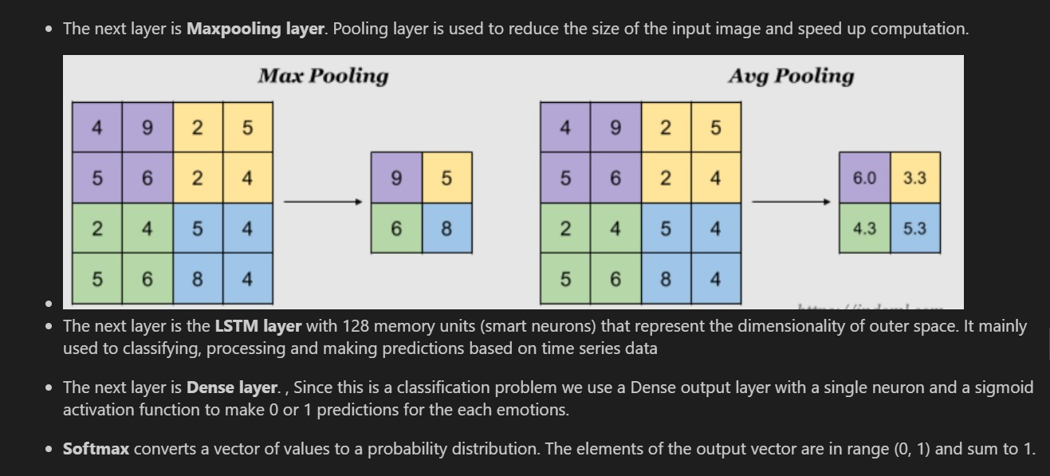
Layers-Ii

Slide 23
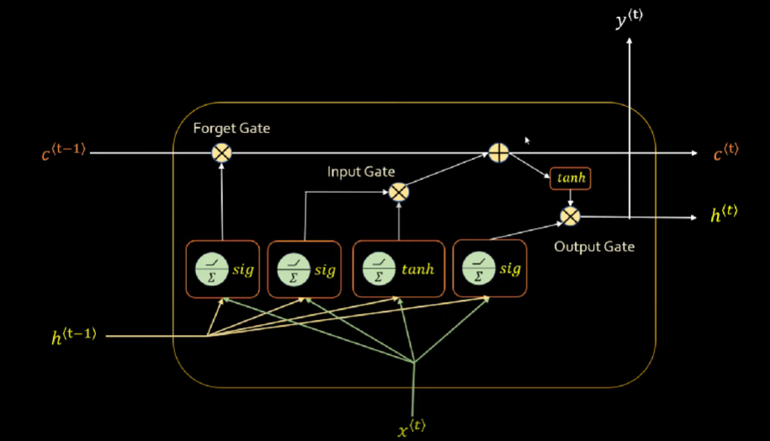

Slide 24
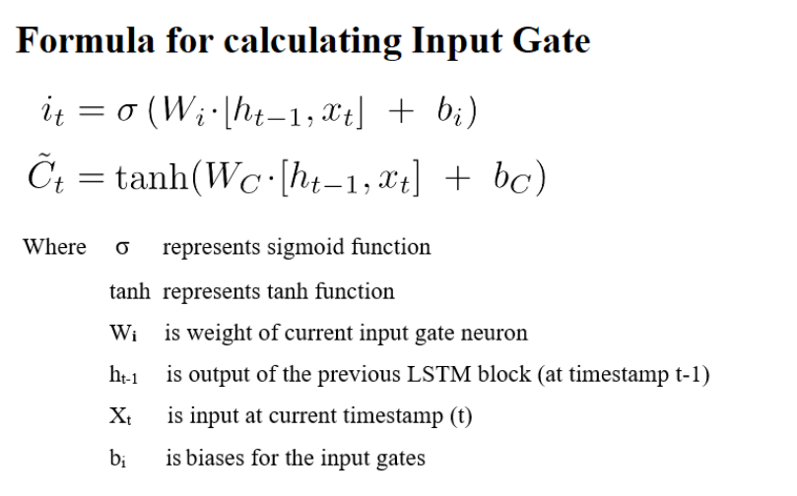
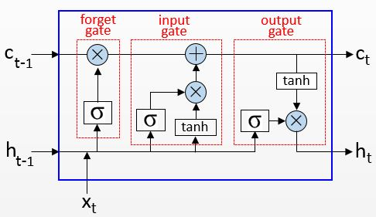
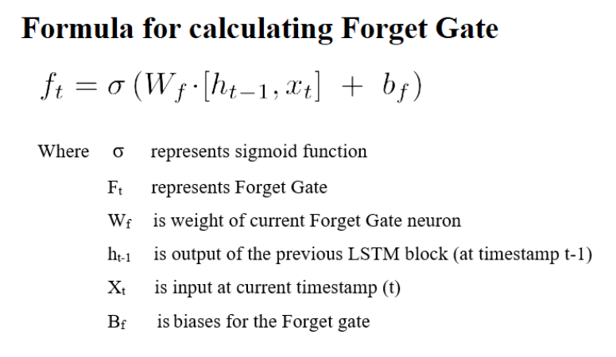
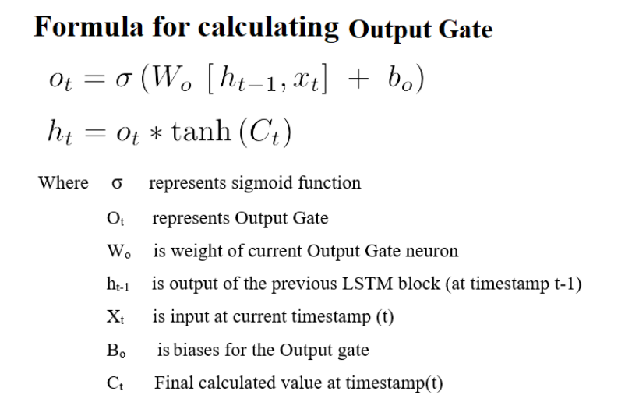

Slide 25
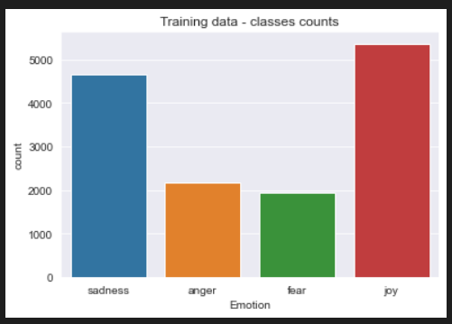
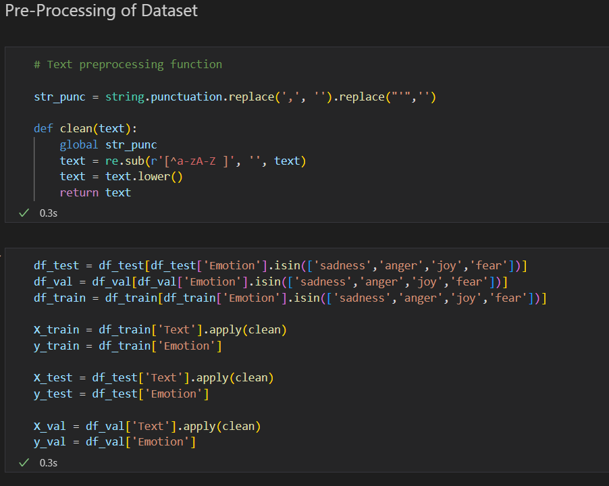
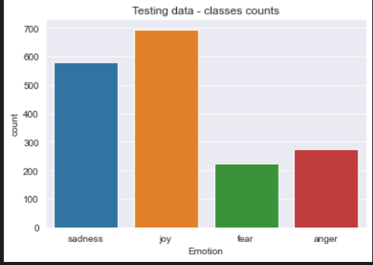
Pre-Processsing

Slide 26
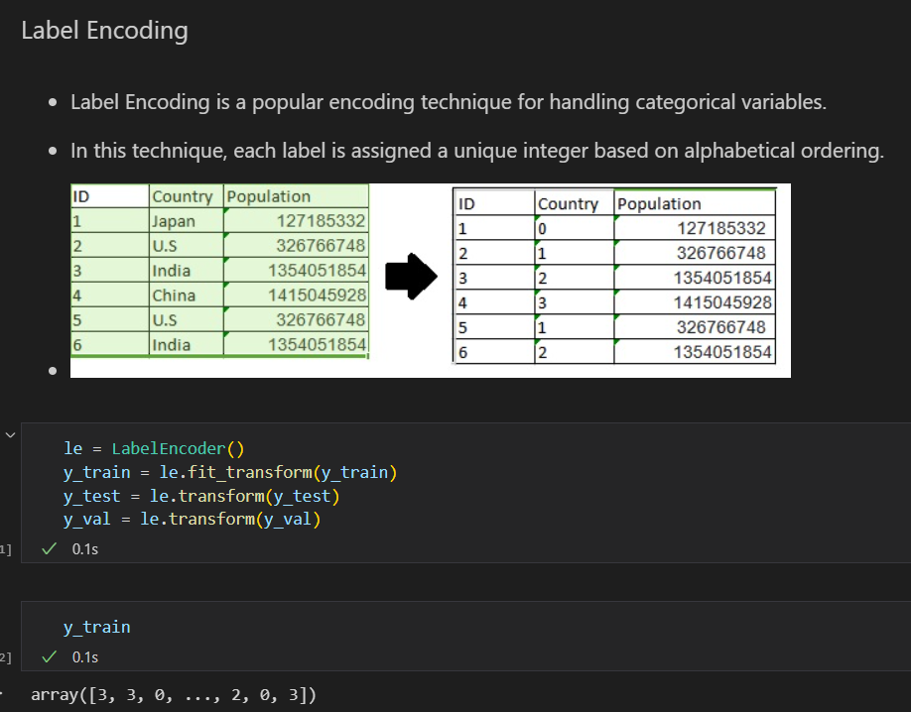
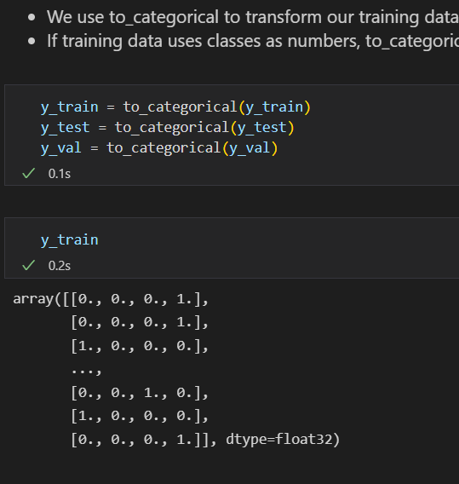
LABEL ENCODING

Slide 27
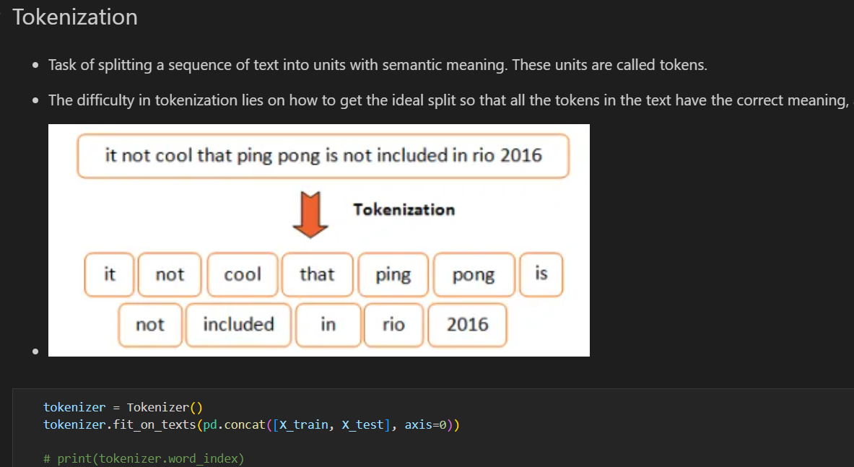

Slide 28
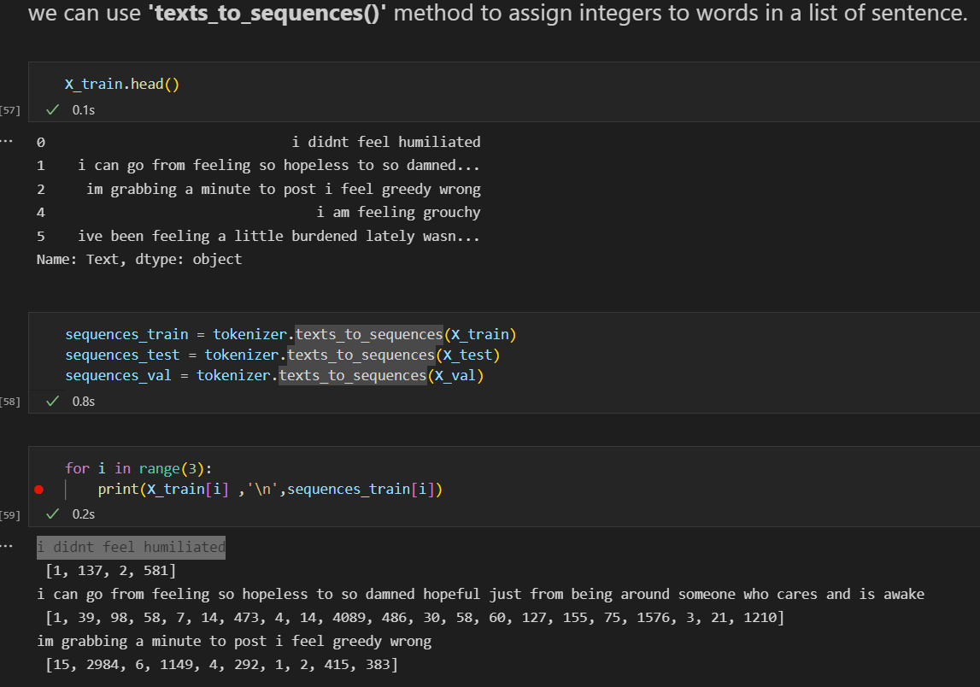
Text 2 Sequence

Slide 29
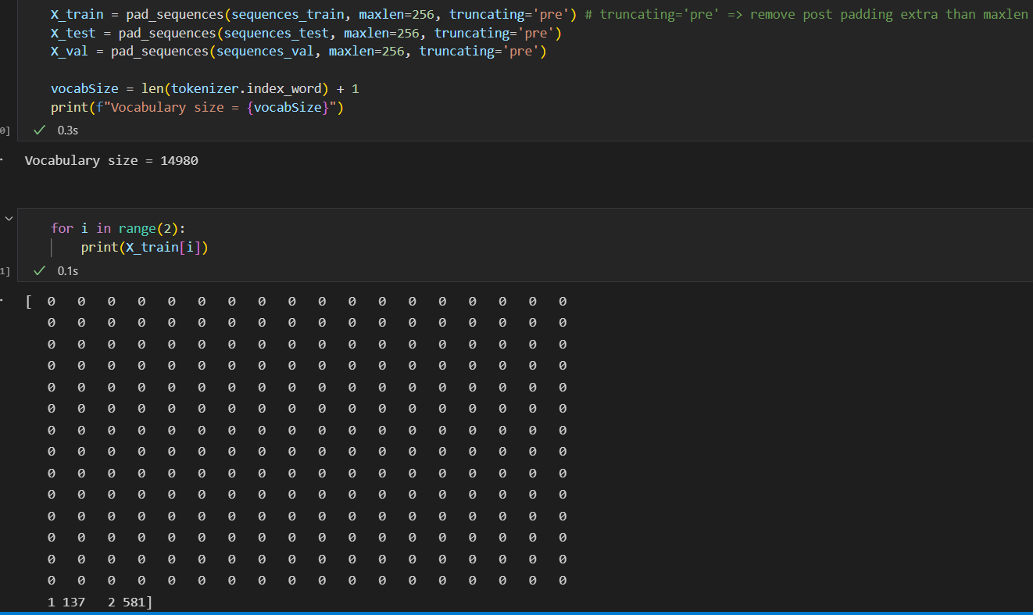
Padding

Slide 30
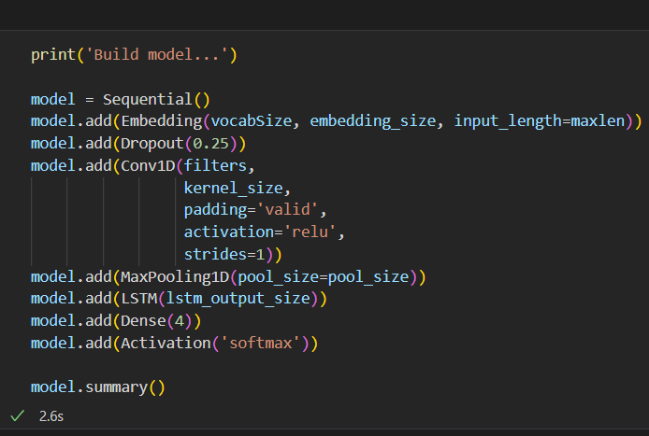
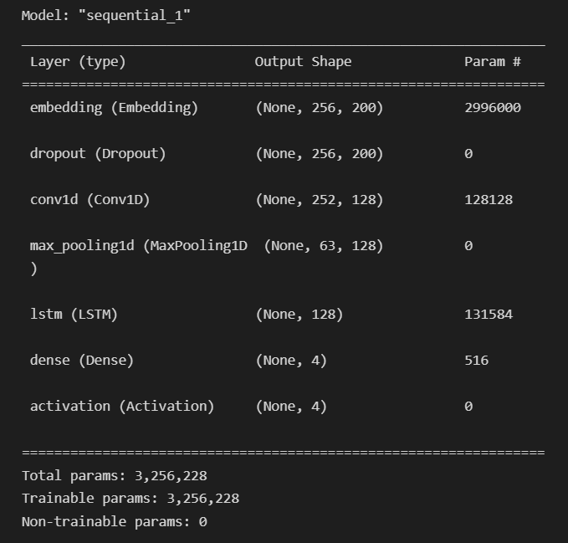
Model Building
Model Summary

Slide 31
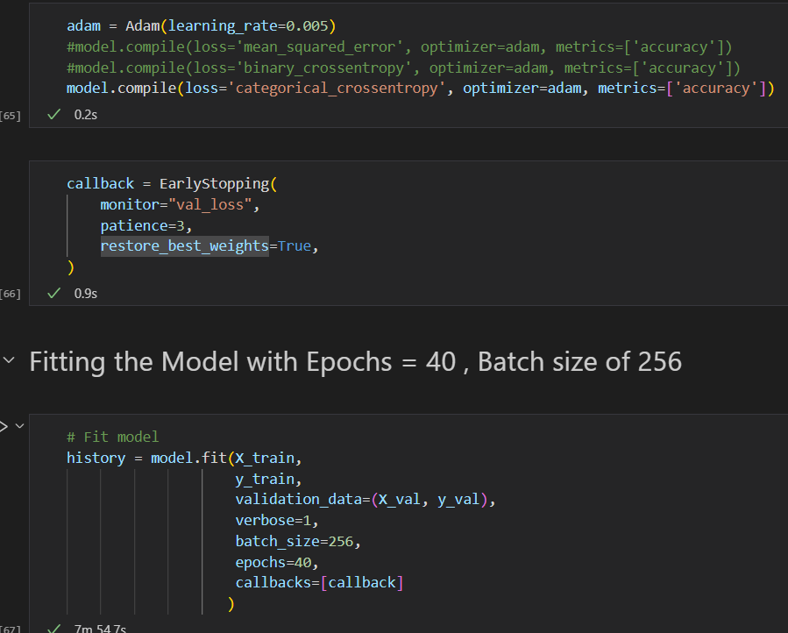
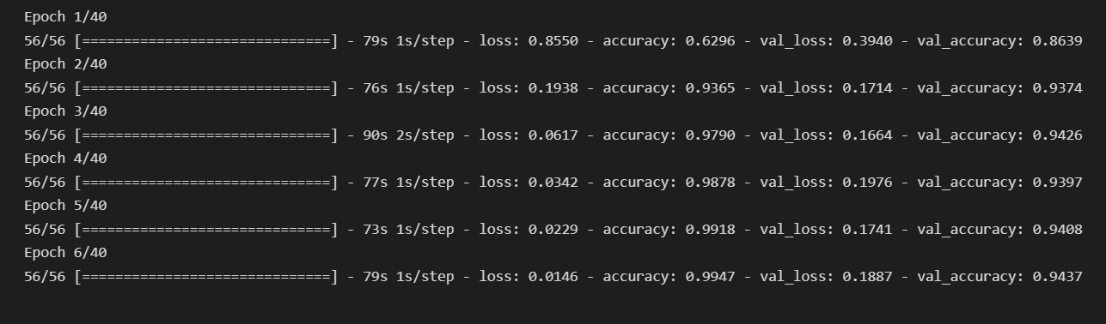
Model Fitting

Slide 32
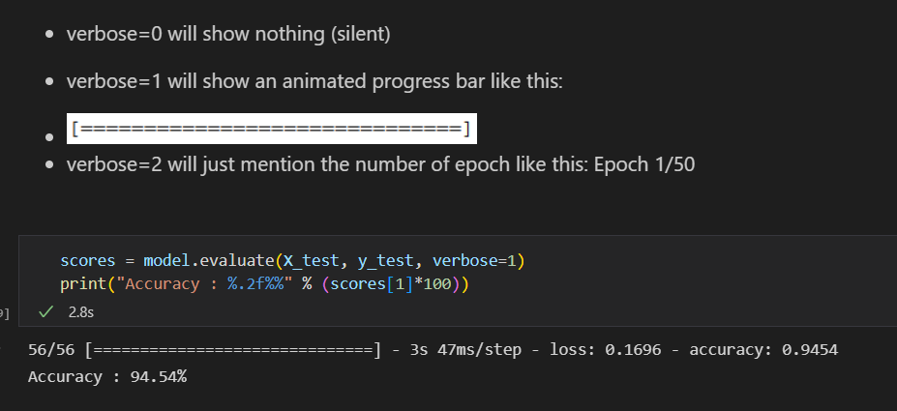
Evaluation

Slide 33
EXAMPLE
OUTPUT
Rohan
95
EMBEDDING
LSTM
FULLY CONNECTED LAYER
SIGMOID
is
216
EMBEDDING
LSTM
SIGMOID
enjoying
825
EMBEDDING
LSTM
SIGMOID
holidays
682
EMBEDDING
LSTM
SIGMOID
in
75
EMBEDDING
LSTM
SIGMOID
Bangalore
215
EMBEDDING
LSTM
SIGMOID

Slide 34
Thank You

